Slide 1
Cloud computing with R
Sam Bashevkin
sam.bashevkin@deltacouncil.ca.gov
Delta Science Program
Delta Stewardship Council

Slide 2
Why cloud compute?
Access to more CPUs and memory than a normal computer could provide.
Only pay for what you use, no maintenance required
Free up your computer for other tasks while large models run in the cloud.
No more crashing your computer every time R uses too much memory
Other reasons?

Slide 3
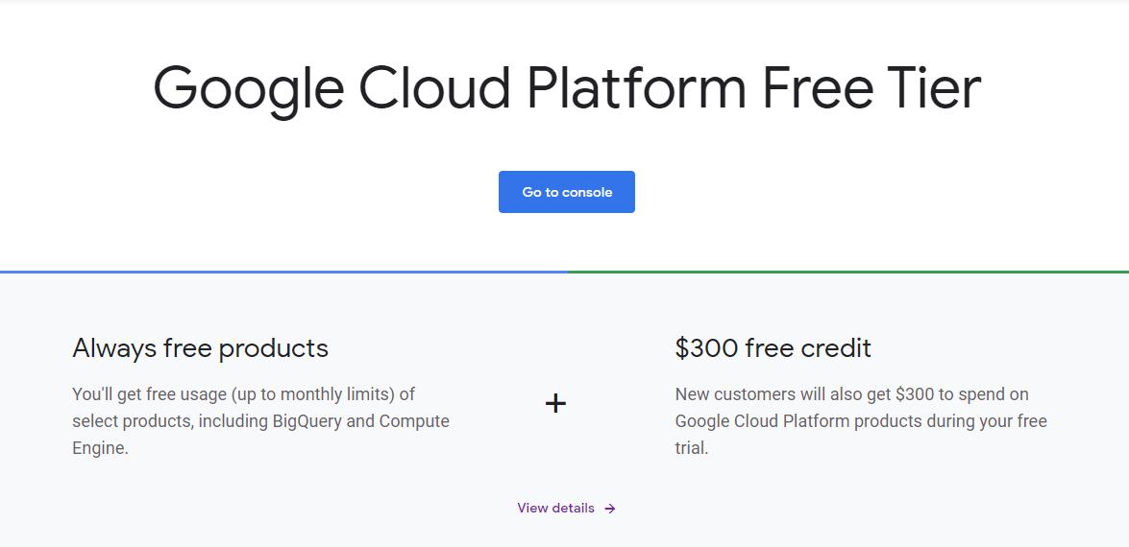
Google Cloud Compute Engine
Free $300 trial for 1 year
Add credit card to gain access to more features and CPUs
You won’t be charged unless you exceed the $300 credit

Slide 4

Google cloud integration with R
googleComputeEngineR package
googleCloudStorageR package
Many other R cloud packages are part of the cloudr project

Slide 5
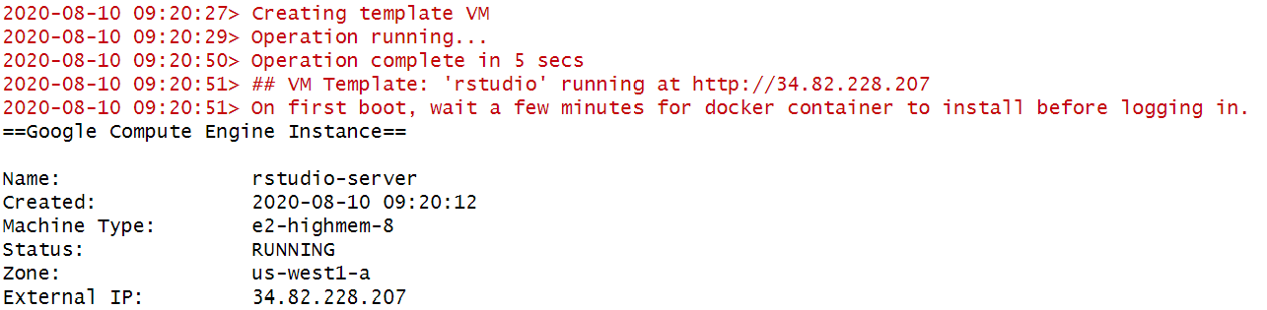
Set up a virtual machine
First, follow setup tutorial to set up credentials
Next, set up virtual machine

Slide 6
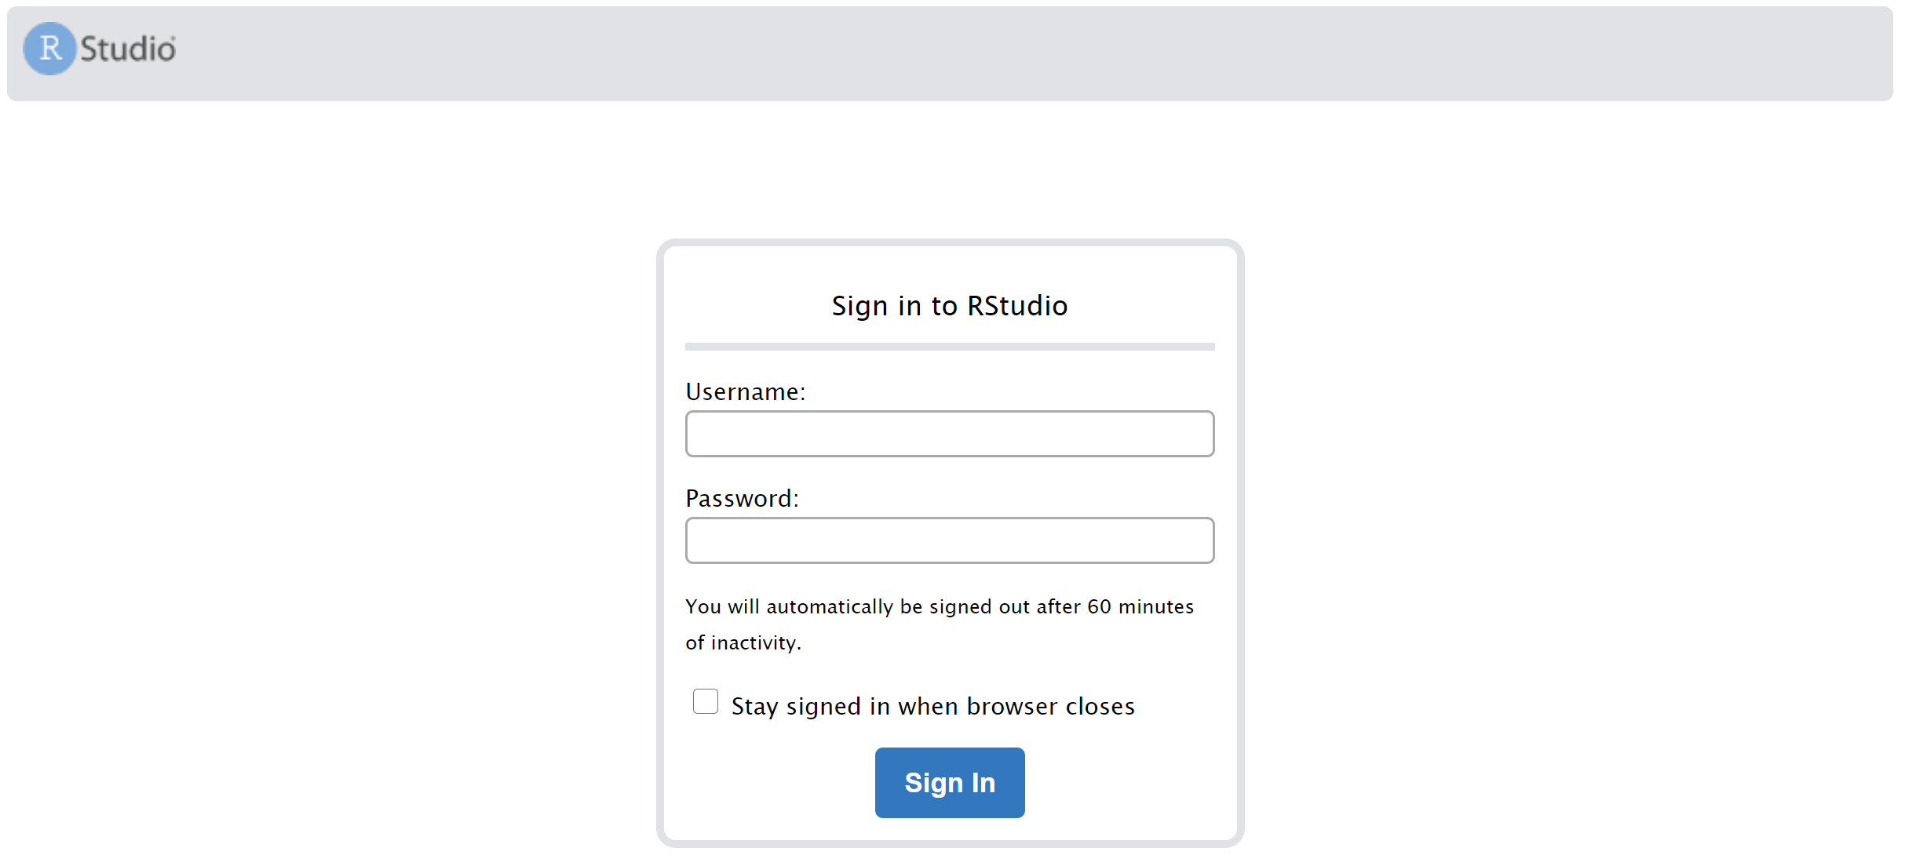
Run R in the cloud
Open IP address in web browser after waiting a minute for it to boot

Slide 7
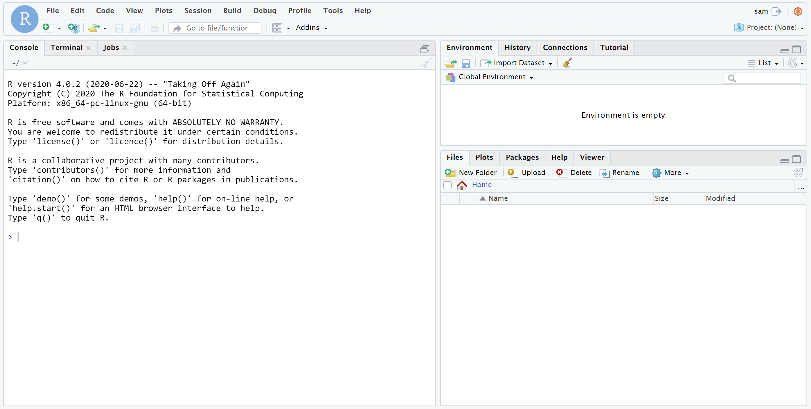
Run R in the cloud

Slide 8
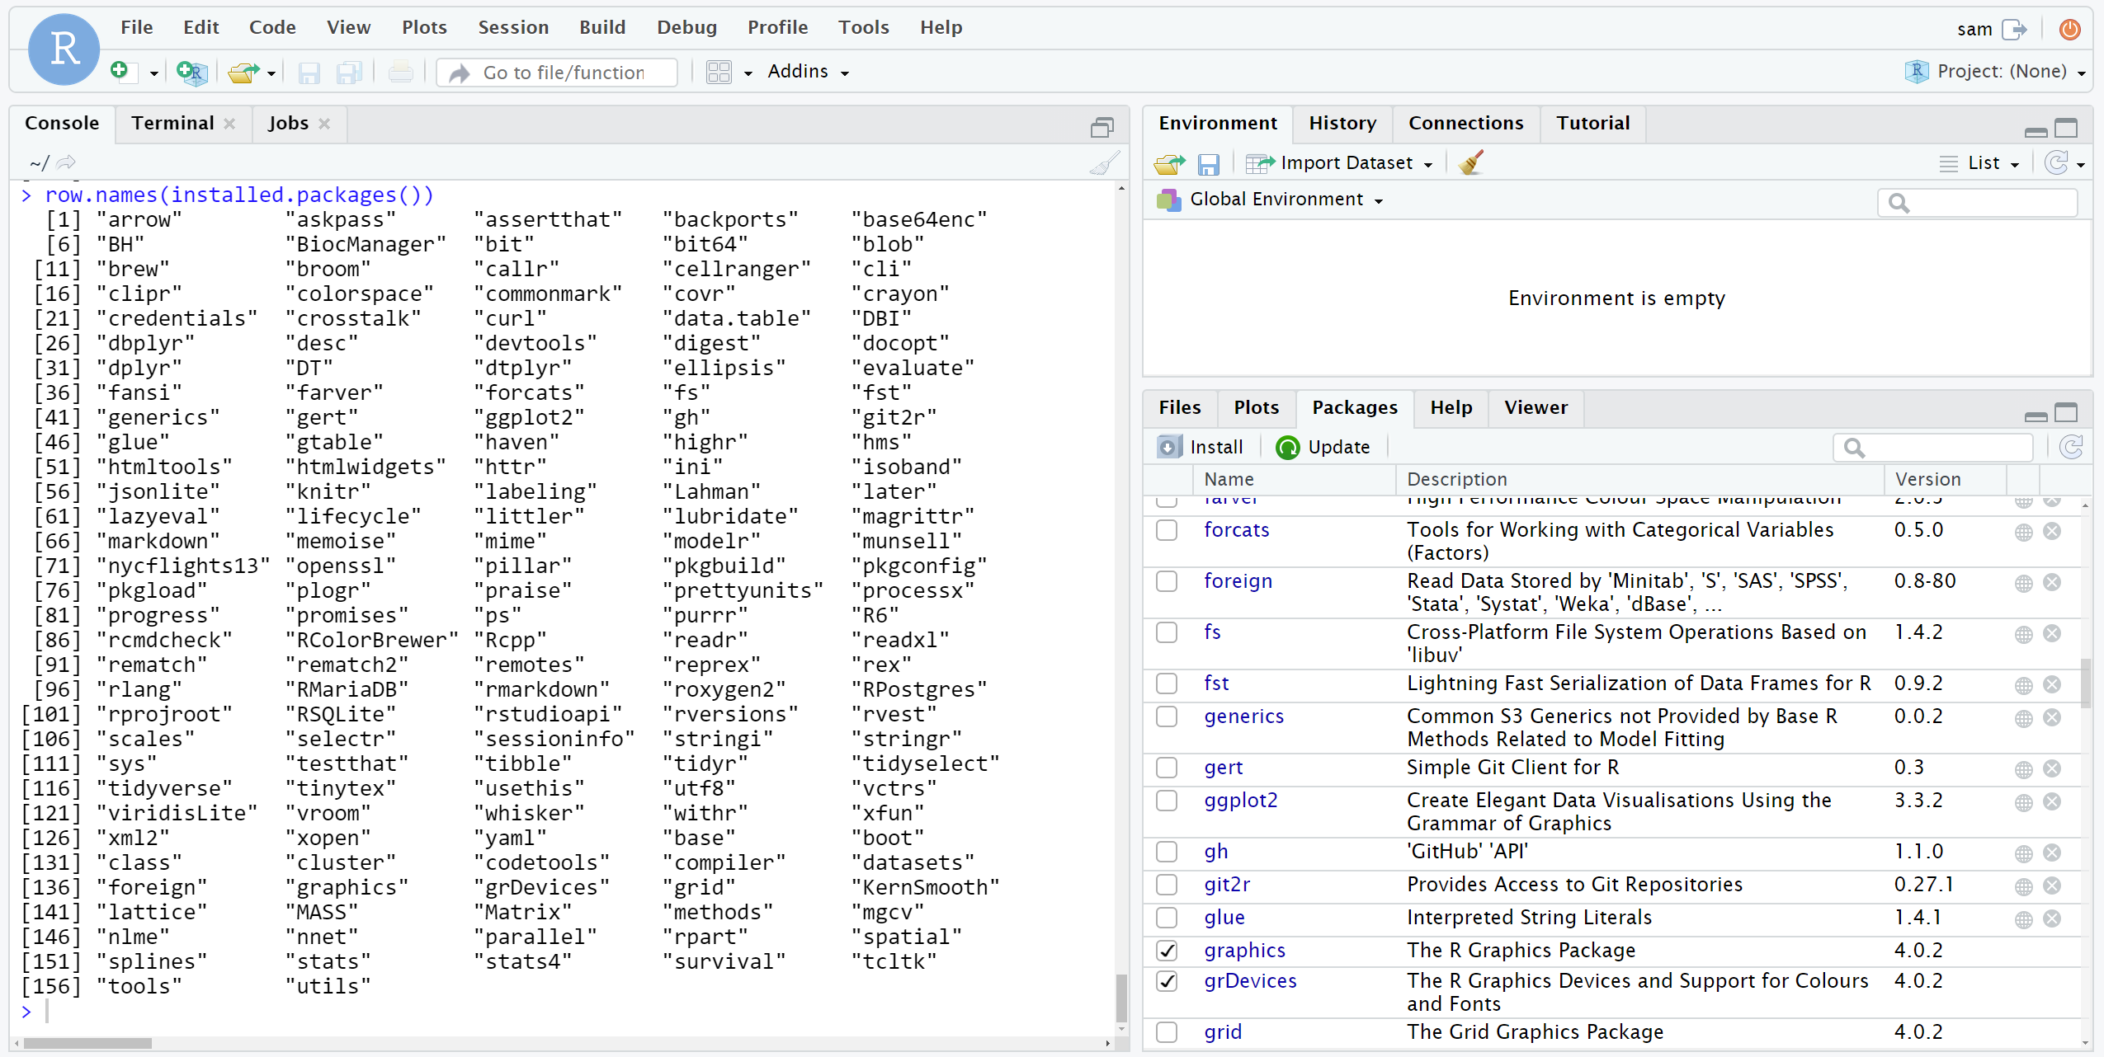
Because we used rstudio template, useful packages are pre-installed

Slide 9
Importing files

Slide 10
When finished, stop and/or delete VM
Through R on your local machine
gce_vm_stop()
gce_vm_delete()
Or through the google cloud platform

Slide 11
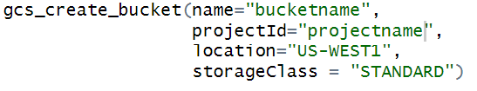
Persistent storage across cloud sessions
Set up google cloud bucket with googleCloudStorageR
Similar credential setup process as googleComputeEngineR

Slide 12
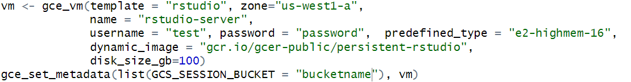
Persistent storage across cloud sessions
Machine image with extra features for persistant storage (e.g., the googleComputeEngineR and googleCloudStorageR packages pre-installed)
Setup persistant VM and link to cloud storage
Not necessary, but this is how you can increase the disk storage for a VM if you need to upload or produce larger files
Links VM to cloud bucket

Slide 13
Persistent storage across cloud sessions
Use googleCloudStorageR functions to transfer files between local or remote machine and cloud bucket
gcs_upload to upload individual files
gcs_save_all to upload all files in a directory
If you use a consistent username when creating your VMs, this function can create and update a bucket that is automatically downloaded to remote VMs on startup
There are tutorials on the googleComputeEngineR website for seamless persistent storage across VMs
I have been unable to get any of these to work

